Slide 1
Locally Hosted RAG pipeline with Language Model
Junaid Yeasir Fahim

Slide 2
Introduction
- Project Overview - Design Constraints - Current Status - Known Risks

Slide 3
Project Overview
The Retrieval-Augmented Generation (RAG) project aims to develop a system that can answer questions based on the content of a given PDF document. The RAG system combines information retrieval techniques with language generation models to provide accurate and relevant answers to user queries. By leveraging vector embeddings and similarity search, the system retrieves the most relevant context from the PDF document and generates human-like responses using a language model.

Slide 4
Design Constraints
Input Format: The RAG system is designed to work with PDF documents as input. It assumes that the PDF documents are in a compatible format that can be processed by the UnstructuredPDFLoader library.
Language Model: The system relies on the Ollama language model for generating vector embeddings and answering questions. It requires the Ollama model to be properly installed and configured.
Vector Database: The RAG system uses the Chroma vector database for storing and retrieving document chunks and their vector embeddings. It assumes that the Chroma database is set up and accessible.
Computational Resources: The system may require significant computational resources, especially for processing large PDF documents and generating vector embeddings. The availability of adequate computational power and memory should be considered.

Slide 5
Current Status
The RAG project is currently in the development phase. The following milestones have been achieved:
Initial system architecture and design have been established.
The PDF ingestion component has been implemented using the UnstructuredPDFLoader library.
Vector embeddings generation using the Ollama language model has been integrated.
The Chroma vector database has been set up for storing and retrieving document chunks and embeddings.
A basic command-line interface has been developed for user interaction.
The system is currently undergoing testing and refinement to improve its performance and usability.

Slide 6
Known Risks
PDF Compatibility: The RAG system relies on the UnstructuredPDFLoader library to process PDF documents. There may be compatibility issues with certain PDF formats or documents with complex layouts, which could affect the extraction of text content.
Language Model Performance: The quality of the generated answers depends on the performance of the Ollama language model. If the model fails to generate accurate or coherent responses, it could impact the overall effectiveness of the RAG system.
Scalability: Processing large PDF documents and generating vector embeddings can be computationally intensive. The system's scalability may be limited by the available computational resources, especially when dealing with a high volume of documents or concurrent user requests.
Domain-Specific Knowledge: The RAG system's performance may vary depending on the domain and complexity of the PDF documents. Documents containing highly specialized or technical content may require additional training or fine-tuning of the language mode

Slide 7
Project Objectives
- Develop a RAG system for question answering - Enable efficient retrieval of relevant context - Generate accurate and coherent answers - Provide a user-friendly interface - Optimize system performance - Ensure scalability and extensibility - Document and share the RAG system

Slide 8
Project Objectives
Develop a RAG system for question answering
Design and implement a RAG system that can answer questions based on the content of a given PDF document.
Integrate components for document ingestion, vector embeddings generation, vector database storage, and retrieval-based question answering.
Enable efficient retrieval of relevant context
Implement a retrieval mechanism that efficiently searches for relevant context within the PDF document based on the user's question.
Utilize vector embeddings and similarity search techniques to identify the most relevant passages or chunks of text.
Generate accurate and coherent answers
Develop a question-answering component that generates accurate and coherent answers based on the retrieved context.
Leverage a language model to generate human-like responses that effectively address the user's question.
Provide a user-friendly interface
Design a simple and intuitive command-line interface for users to interact with the RAG system.
Allow users to input their questions and receive generated answers in a clear and readable format.

Slide 9
Project Objectives(contd)
5. Optimize system performance
Conduct experiments and evaluations to measure and optimize the performance of the RAG system.
Fine-tune the retrieval and question-answering components to improve the accuracy and relevance of the generated answers.
Explore techniques such as hyperparameter tuning, ablation studies, and comparative analysis to enhance system performance.
6. Ensure scalability and extensibility
Design the RAG system architecture to be scalable and extensible.
Allow for the integration of additional PDF documents or other data sources without significant modifications to the system.
Implement modular components that can be easily updated or replaced as new techniques or models become available.
7. Document and share the RAG system
Provide comprehensive documentation of the RAG system, including system architecture, design choices, and usage instructions.
Share the project code, datasets, and experimental results with the research community to facilitate further research and collaboration

Slide 10

Software System Architecture - Overview
- System components - Information flow - System inputs and outputs

Slide 11
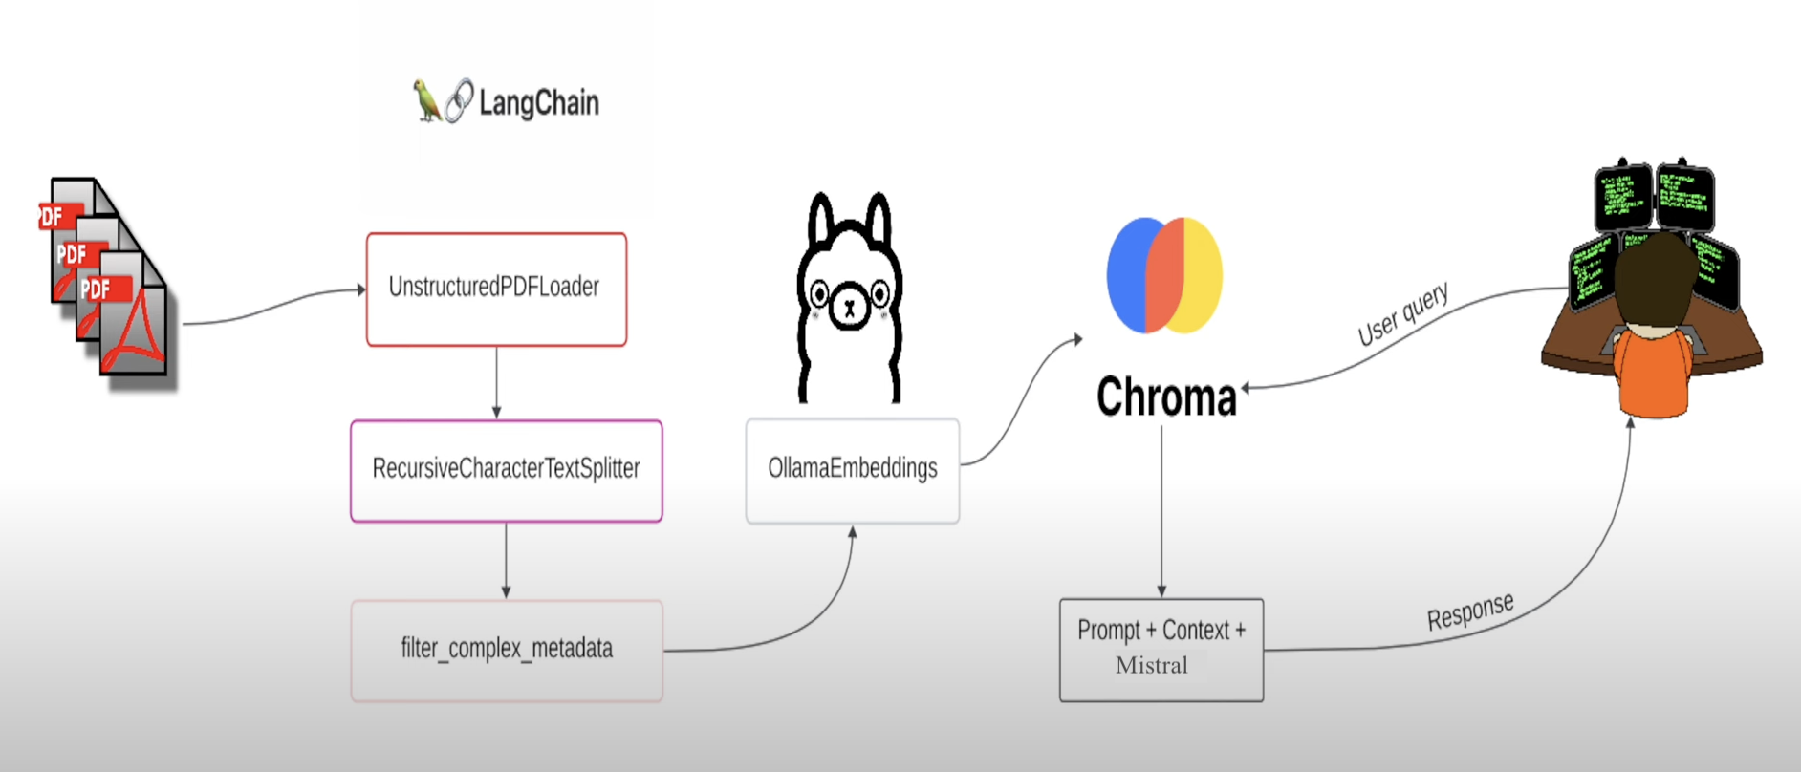
Fig: Information flow diagram of the high-level architecture

Slide 12

Software System Architecture - Components
- Hardware Components - Software Components - Databases and Files - Human Interface

Slide 13
System Components
Hardware Components
User's computer or device running the Python script
Software Components
Python programming language
Libraries:
unstructured: For handling PDF documents
langchain and langchain_community: For building the retrieval and question-answering pipeline
ollama: For generating text embeddings
chromadb: For vector database storage
langchain-text-splitters: For splitting text into chunks
Databases and Files
Local PDF file: "WEF_The_Global_Cooperation_Barometer_2024.pdf"
Vector database: Stores document chunks and their vector embeddings
Human Interface
Command-line interface: Users interact with the system by running the Python script and entering questions when prompted

Slide 14
Information Flow
The user provides the local PDF file path when running the script.
The script loads the PDF using the UnstructuredPDFLoader and previews the first page content.
The loaded PDF data is split into chunks using the RecursiveCharacterTextSplitter.
The document chunks are stored in the vector database along with their vector embeddings generated by OllamaEmbeddings.
The user enters a question when prompted.
The MultiQueryRetriever generates five different versions of the user question using the query prompt template and the language model.
The retriever queries the vector database to retrieve relevant context based on the generated question variations.
The retrieved context and the user question are combined using the prompt template.
The language model generates an answer based on the combined prompt.
The answer is parsed and presented to the user.

Slide 15

System Inputs and Outputs
Inputs:
Local PDF file path
User question
Outputs:
Generated answer based on the retrieved context and user question

Slide 16
Experimental Methodology - Evaluation Metrics
- Retrieval Accuracy - Metrics: Precision, Recall, F1-score - Answer Quality - Metrics: BLEU score, ROUGE score, human evaluation

Slide 17

Evaluation Metrics
Retrieval Accuracy
Measure the accuracy of the retrieval component in finding relevant context for a given question.
Metrics: Precision, Recall, F1-score
Process:
Prepare a labeled dataset with questions and corresponding relevant context.
Run the RAG system on the dataset and compare the retrieved context with the labeled relevant context.
Calculate precision, recall, and F1-score based on the comparison.
Answer Quality
Assess the quality and relevance of the generated answers.
Metrics: BLEU score, ROUGE score, human evaluation
Process:
Prepare a labeled dataset with questions and corresponding reference answers.
Run the RAG system on the dataset and generate answers for each question.
Calculate BLEU and ROUGE scores by comparing the generated answers with the reference answers.
Conduct human evaluation to assess the quality, relevance, and coherence of the generated answers.

Slide 18
Experimental Methodology - Experimental Setup
- Dataset Preparation - Hyperparameter Tuning - Ablation Studies - Comparative Analysis

Slide 19

Experimental Setup
Dataset Preparation
Collect a diverse set of PDF documents covering various domains and topics.
Annotate the documents with relevant questions and corresponding answers.
Split the dataset into training, validation, and testing subsets.
Hyperparameter Tuning
Identify key hyperparameters that impact the system's performance (e.g., chunk size, embedding model, retrieval algorithm).
Conduct a grid search or random search over the hyperparameter space.
Evaluate the system's performance on the validation set for each hyperparameter combination.
Select the best-performing hyperparameter configuration.
Ablation Studies
Investigate the impact of different components and techniques used in the RAG system.
Conduct experiments by removing or modifying specific components (e.g., using a different embedding model, retrieval algorithm, or language model).
Evaluate the system's performance with each modification and analyze the results.
Comparative Analysis
Compare the RAG system's performance with other baseline methods or state-of-the-art approaches.
Implement or utilize existing methods for comparison.
Evaluate the RAG system and the baseline methods using the same dataset and evaluation metrics.
Analyze the strengths and weaknesses of the RAG system compared to other approaches.

Slide 20

Requirements
Labeled dataset with PDF documents, questions, and corresponding answers.
Computational resources (e.g., GPU) for training and evaluating the RAG system.
Evaluation scripts for calculating metrics and conducting experiments.
Data storage for storing the datasets, models, and experimental results.

Slide 21

Software Design - Components
- PDF Ingestion - Vector Embeddings Generation - Vector Database - Retrieval and Question Answering

Slide 22
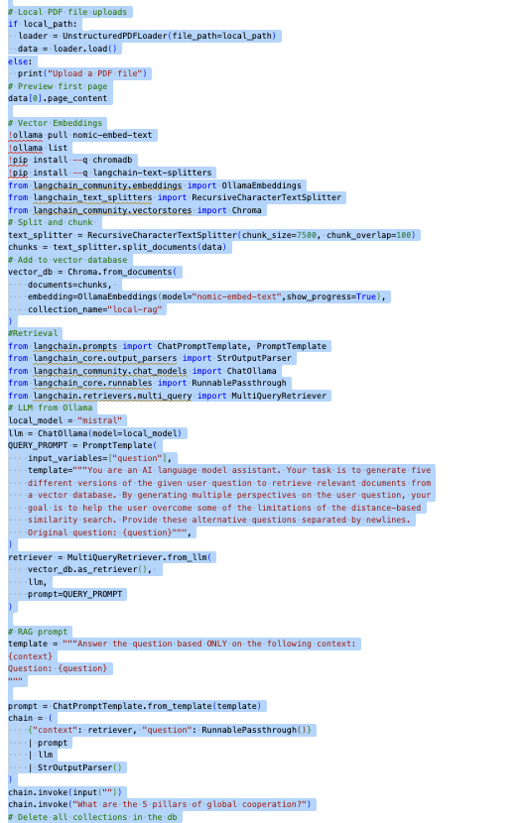

Slide 23
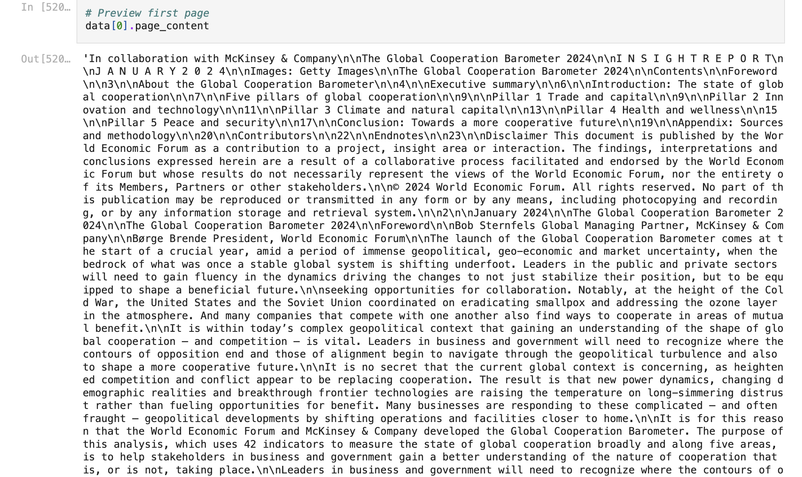
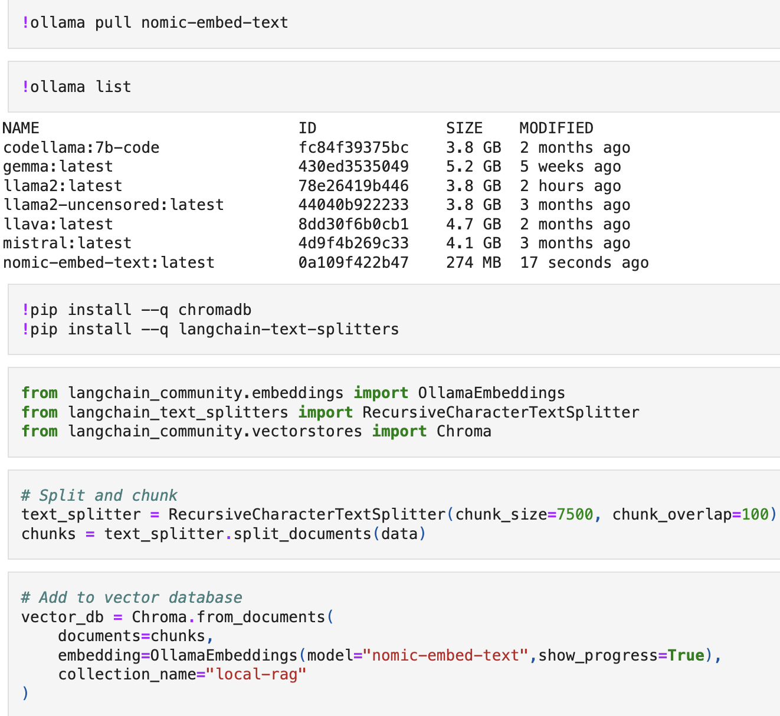
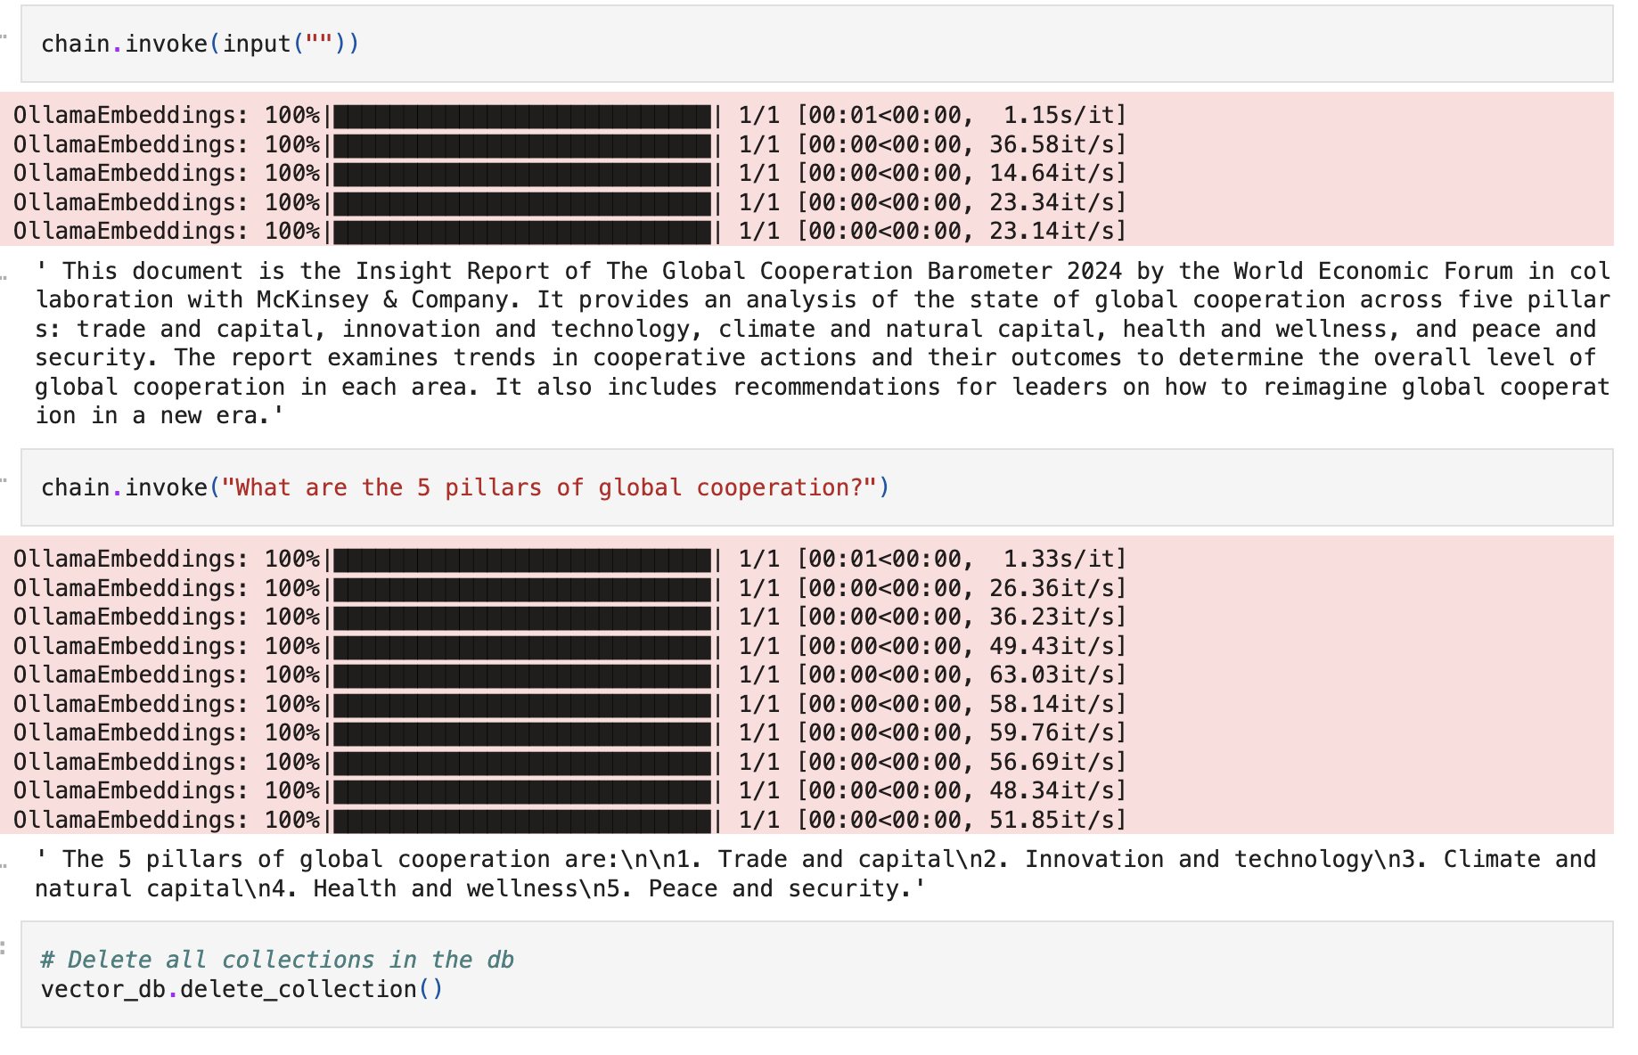
Fig: uploading the pdf file and seeing the first page
Fig: importing necessary libraries, text splitting
and adding them to vector database
Fig: Using Langchain to ask questions and getting the results

Slide 24
Components
PDF Ingestion
Responsible for loading and processing the PDF document
Uses the UnstructuredPDFLoader class from the langchain_community library
Vector Embeddings Generation
Generates vector embeddings for the document chunks
Uses the OllamaEmbeddings class from the langchain_community library
Vector Database
Stores the document chunks along with their vector embeddings
Uses the Chroma class from the langchain_community library
Retrieval and Question Answering
Retrieves relevant context based on user questions
Generates answers using the retrieved context and a language model
Uses the MultiQueryRetriever, ChatOllama, and other classes from the langchain and langchain_community libraries

Slide 25
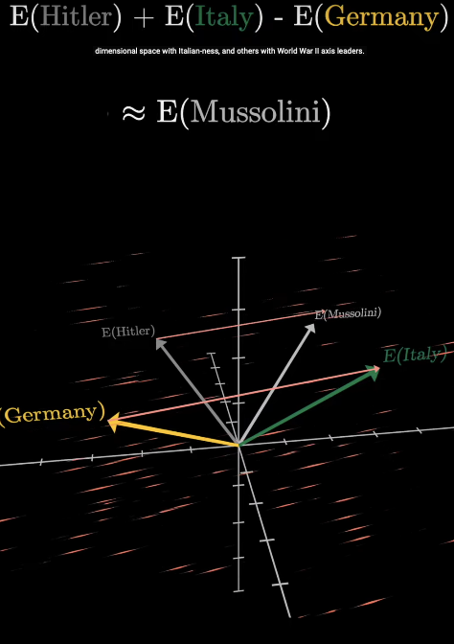
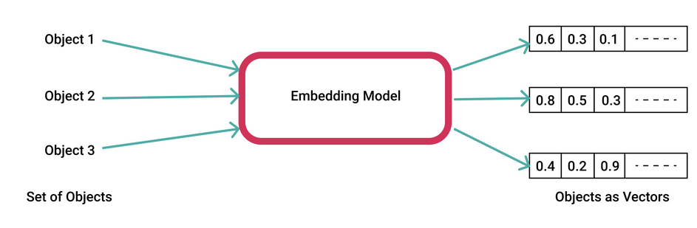
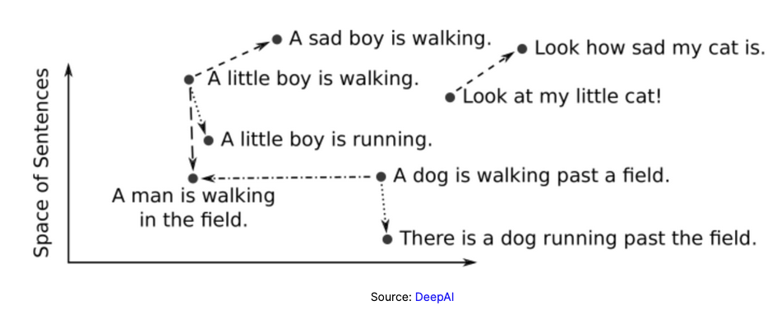
Fig: Embedding model design
Fig: Vector space of sentences (In 2-D)
Fig: words and their embedding vectors

Slide 26

Software Design - Classes and Functions
- Key Classes: - UnstructuredPDFLoader, RecursiveCharacterTextSplitter, OllamaEmbeddings, Chroma, MultiQueryRetriever, ChatOllama - Main Functions: - load_document(), split_document(), create_vector_database(), generate_answer()

Slide 27

Software Design - Data Structures
- DocumentChunk - VectorEmbedding

Slide 28
Classes
UnstructuredPDFLoader
Loads and processes PDF documents
Provided by the langchain_community library
RecursiveCharacterTextSplitter
Splits text into smaller chunks
Provided by the langchain_text_splitters library
OllamaEmbeddings
Generates vector embeddings for text using the Ollama model
Provided by the langchain_community library
Chroma
Represents the vector database for storing document chunks and their embeddings
Provided by the langchain_community library
MultiQueryRetriever
Retrieves relevant context based on multiple query variations
Provided by the langchain library
ChatOllama
Language model used for generating answers
Provided by the langchain_community library

Slide 29
Functions & Data Structures
load_document(file_path)
Loads a PDF document using the UnstructuredPDFLoader
Returns the loaded document data
split_document(data, chunk_size, chunk_overlap)
Splits the loaded document data into smaller chunks using the RecursiveCharacterTextSplitter
Returns the list of document chunks
create_vector_database(chunks, embedding_model)
Creates a vector database using the Chroma class
Stores the document chunks along with their vector embeddings generated by the specified embedding model
Returns the created vector database
generate_answer(question, retriever, prompt, llm)
Retrieves relevant context based on the user question using the MultiQueryRetriever
Combines the retrieved context and the user question using the prompt template
Generates an answer using the language model (ChatOllama)
Returns the generated answer
Data Structures
DocumentChunk
Represents a chunk of the document
Contains the text content and metadata of the chunk
VectorEmbedding
Represents the vector embedding of a document chunk
Used for similarity search and retrieval

Slide 30
Systems Interface Design - Human Interface
- Command-line interface (CLI) - Human Interaction Narrative - CLI Mockup

Slide 31

Human Interface Design
The RAG system interacts with humans through a command-line interface (CLI). The user runs the Python script and enters questions when prompted.
Human Interaction Narrative
The user opens a terminal or command prompt.
The user navigates to the directory where the RAG project script is located.
The user runs the Python script by executing the appropriate command (e.g., python rag_script.py).
The script loads the PDF document and generates vector embeddings for the document chunks.
The script prompts the user to enter a question.
The user types their question and presses Enter.
The script processes the user's question, retrieves relevant context from the vector database, and generates an answer using the language model.
The generated answer is displayed to the user in the terminal.
The user can enter another question or terminate the script.

Slide 32
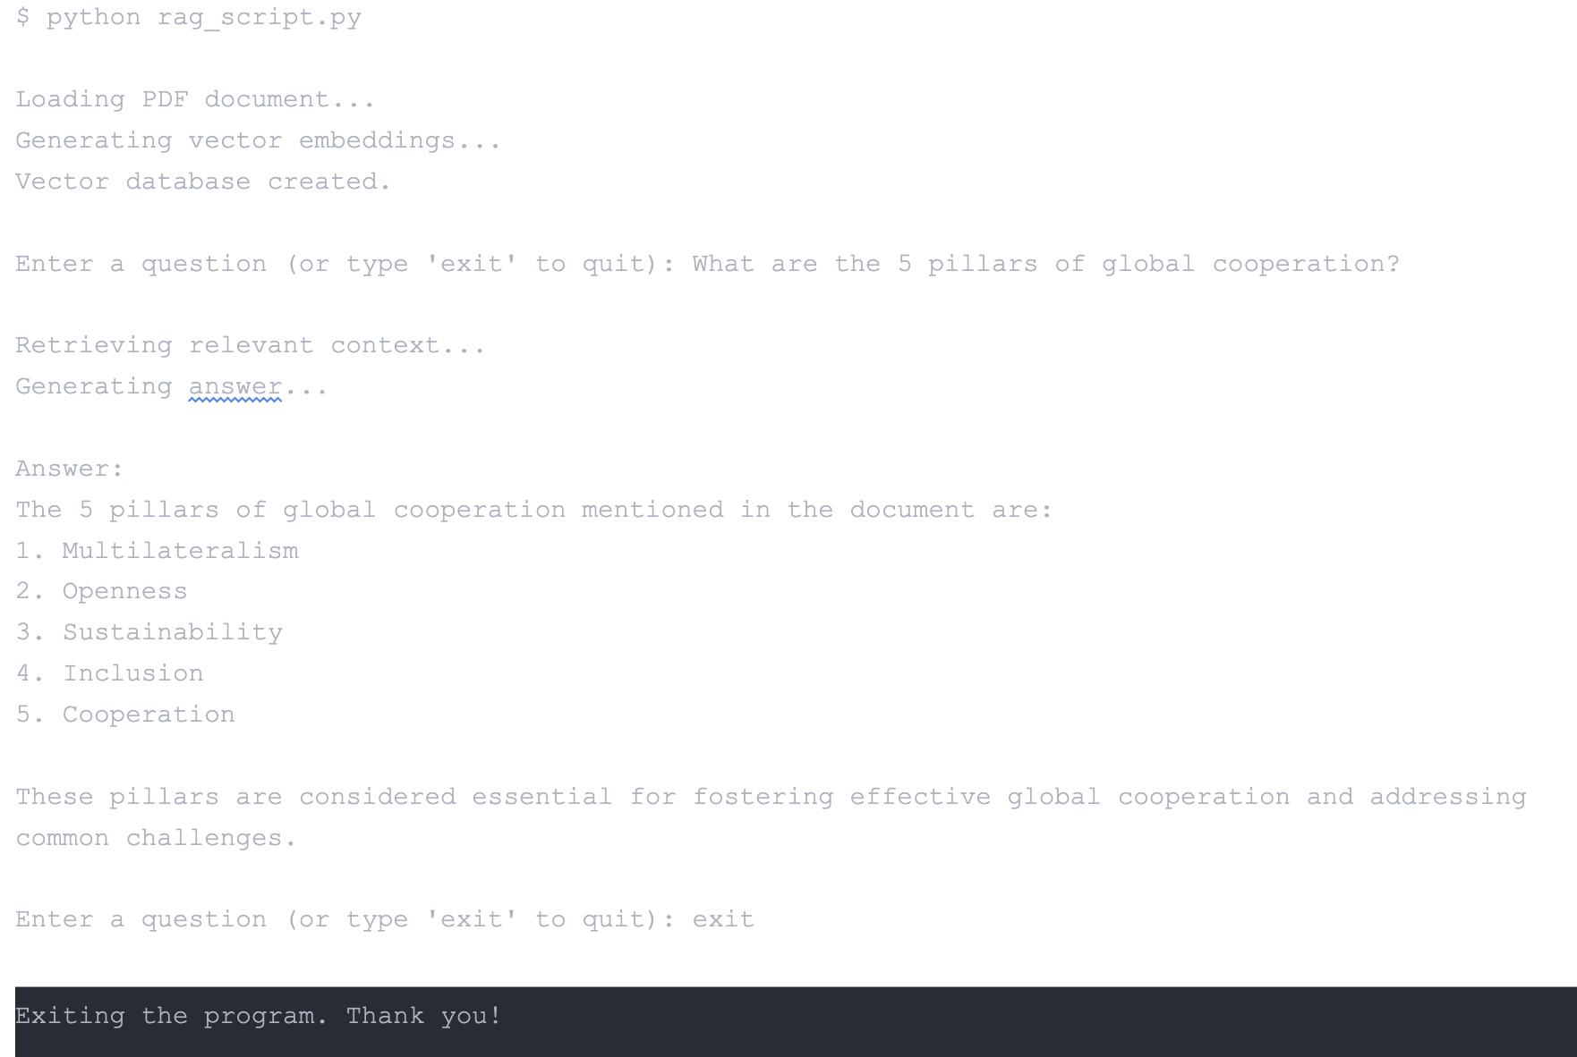
CLI Mockup

Slide 33
Systems Interface Design - External Interfaces
- PDF Document - Ollama Language Model - Chroma Vector Database

Slide 34

External Interfaces
The RAG system interacts with the following external software components:
PDF Document
The system requires a PDF document as input.
The PDF document is loaded using the UnstructuredPDFLoader class from the langchain_community library.
The PDF document is assumed to be in a compatible format that can be processed by the UnstructuredPDFLoader.
Ollama Language Model
The system uses the Ollama language model for generating vector embeddings and answering questions.
The OllamaEmbeddings class from the langchain_community library is used to generate vector embeddings for the document chunks.
The ChatOllama class from the langchain_community library is used as the language model for generating answers.
The system assumes that the Ollama language model is properly installed and configured.
Chroma Vector Database
The system uses the Chroma vector database to store and retrieve document chunks and their vector embeddings.
The Chroma class from the langchain_community library is used to create and interact with the vector database.
The system assumes that the Chroma database is properly installed and configured.

Slide 35

Detailed Hardware Design
- Hardware Components - Power Requirements

Slide 36
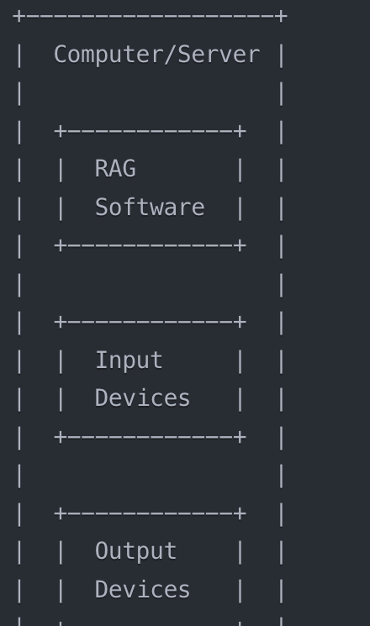
Hardware Components
Computer or Server
The RAG system requires a computer or server to execute the Python script and run the necessary software components.
Recommended specifications:
Processor: Multi-core CPU (e.g., Intel Core i5 or higher)
Memory: 8 GB RAM or higher
Storage: Sufficient disk space to store the PDF document, vector database, and any intermediate files generated during the process.
Operating System: Compatible with Python and the required libraries (e.g., Windows, macOS, Linux)
Input Devices
Keyboard: Used to enter questions and interact with the command-line interface.
Output Devices
Display: Used to view the command-line interface and the generated answers.

Slide 37

Racial and Gender Equity Considerations
- Accessibility - Use Cases - Unbiased and Inclusive Design - Diverse Dataset - Continuous Improvement

Slide 38
The Retrieval-Augmented Generation (RAG) project aims to provide equal access to information and knowledge extraction from PDF documents, regardless of racial or gender background. The system is designed to be inclusive and unbiased, ensuring that all users can benefit from its capabilities.

Slide 39

Accessibility & Use Cases
The RAG system is designed to be easily deployable in various environments, including areas with limited internet or server access capabilities.
By enabling local hosting of the RAG system, we aim to bridge the digital divide and provide access to information retrieval and question-answering capabilities to underserved communities.
This local hosting feature is particularly beneficial for users in rural or remote areas, where internet connectivity may be limited or unreliable.
Medical Researchers in Rural Villages
Medical researchers working in rural villages often have limited access to online resources and databases.
The RAG system can be hosted locally, allowing researchers to process and extract information from patient documents, medical records, and research papers stored in PDF format.
This enables researchers to quickly obtain relevant information and insights, even in areas with limited internet connectivity.
Educational Institutions in Underprivileged Areas
Educational institutions in underprivileged areas may lack access to extensive online libraries and research databases.
By hosting the RAG system locally, these institutions can provide students and faculty with the ability to extract knowledge from PDF documents, such as textbooks, research papers, and educational materials.
This helps bridge the knowledge gap and provides equal access to information for students from diverse racial and gender backgrounds.

Slide 40
The End
Thank You!
Questions?

